Slide 1
System Processors & CPU Architecture Summary System Processors CPU Architecture - RISC and CISC Architecture Introduction to Graphics Processors

Slide 2
System Processors
Both families use x86 instruction set
CPU hardware very different between Intel & AMD
software compatible
Intel – Core i3 (low end), i5 (mid range), i7 (high end) ,
- i9 (higher performance for gamers/PC enthusiasts)
AMD
first to bring 64 bit CPU to desktop
first to attach memory directly to CPU
first to offer desktop multicore CPUs

Slide 3
Sample x86 Assembler
.model small
.stack 100h
.data msg db 'Hello world!$’
.code
start: mov ah, 09h ; Display the message lea dx, msg int 21h mov ax, 4C00h ; Terminate the executable int 21h
end start
From Wikipedia
https://www.cs.virginia.edu/~evans/cs216/guides/x86.html

Slide 4
System Processors
Advanced RISC Machines (ARM)-Mobile Architecture https://versus.com/en/arm-cortex-a53-vs-arm-cortex-a57 designer of a popular low-power CPU (not a manufacturer)
used in smart phones, tablets, embedded systems
not x86 compatible
some chip designs have heterogeneous cores
low-power, low-performance cores (A53) teamed with more powerful but more power-hungry cores (A57).
cores activated or deactivated according to processor workload
very efficient use of electricity

Slide 5
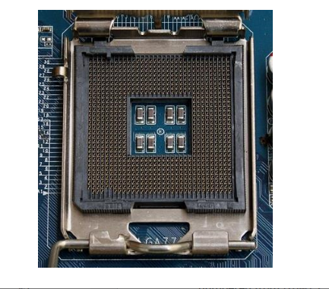
Processor Sockets
CPUs sit in a motherboard socket
motherboard socket has pins, CPU connects with the pins
since Core and Athlon CPUs have different designs, they have different socket designs
newer CPUs might not be supported by older motherboards

Slide 6
CPU Architecture
What does a CPU do?
Grab and execute program instructions
All done over a datapath A datapath has many functional units
We will look at some key ones in the next slide. Another important term to understand is IPC.
Instructions per clock tick (IPC)
amount of work performed per clock tick
some designs have fast clock ticks but lower IPC
faster clock speeds consume more energy

Slide 7
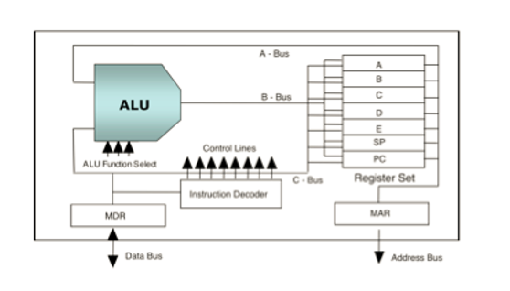
CPU
Arithmetic Logic Unit (ALU) performs arithmetic and logic functions
Registers - high speed ‘scratch pad’ to store data currently being processed
Memory Buffer (Data) Register (MBR,MDR) – stores data just received from, or about to be written to memory
Memory Access Register (MAR) – stores address of memory to be accessed next
Program Counter (PC) – stores address of next instruction

Slide 8
Fetch Execute Cycle
Fetch
Copy PC to MAR
Get instruction into MDR
Decode
Identify operation and operands
Execute
Carry out instruction
May require additional memory fetches
Store
Put data to be stored in MDR
Put location into MAR

Slide 9
Instruction Pipelining
Instruction pipelining (superscalar architectures)
- analogous to an assembly line, where each worker on the line does a small amount of work building an item (say, a car), which moves down the line from one worker to another
- basic instruction cycle (fetch, decode, execute, store) can be pipelined (e.g. while one instruction is being executed, another is being decoded) - steps in the instruction cycle can be broken down into micro-ops that can be pipelined - length of pipeline is called its depth

Slide 10
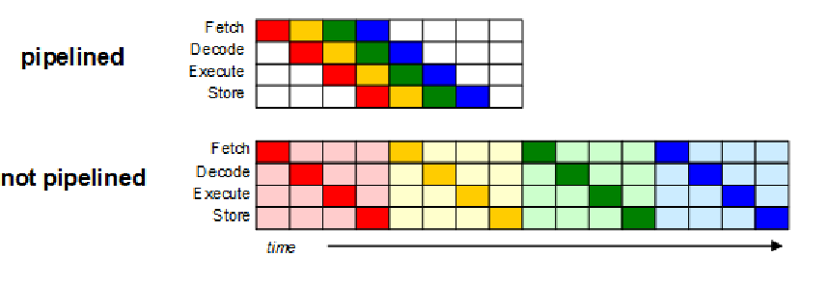
Instruction Pipelining Pipelining enhances throughput – - individual instruction do not run any faster - for example

Slide 11
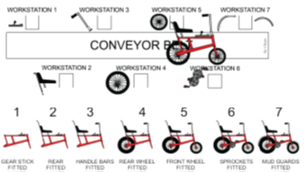
Real World Example We assume that each such bicycle part is available in stock. Assume that each of the 7 stages of production takes 6 minutes

Slide 12
Real World Example cont’d Then it is simple arithmetic to conclude that — from the ﬁrst stage to the last — it takes a total of 42 minutes to fully assemble a bicycle. But it should also be equally simple to conclude that the factory produces one bicycle every 6 minutes. Once the pipeline is full – a bicycle every 6 minutes!
 | Bicycle 1 | Bicycle 2 | Bicycle 3 | Bicycle 4 | Bicycle 5 | Bicycle 6 | Bicycle 7 | Bicycle 8 | Bicycle 9
WS1 | B1 | B2 | B3 | B4 | B5 | B6 | B7 | B8 | B9
WS2 |  | B1 | B2 | B3 | B4 | B5 | B6 | B7 | B8
WS3 |  |  | B1 | B2 | B3 | B4 | B5 | B6 | B7
WS4 |  |  |  | B1 | B2 | B3 | B4 | B5 | B6
WS5 |  |  |  |  | B1 | B2 | B3 | B4 | B5
WS6 |  |  |  |  |  | B1 | B2 | B3 | B4
WS7 |  |  |  |  |  |  | B1 | B2 | B3

Slide 13
Real World Example cont’d Suppose that — for some reason — the fifth stage remains idle for one time slot of 6 minutes. This is a “stall” in the pipeline. Clearly then, in the subsequent consecutive time slots, this idle time of 6 minutes — which we may call a ‘bubble’ — will pass through each of the remaining 3 stages of the pipeline.
 | Bicycle 1 | Bicycle 2 | Bicycle 3 | Bicycle 4 | Bicycle 5 | Bicycle 6 | Bicycle 7 | Bicycle 8 | Bicycle 9
WS1 | B1 | B2 | B3 | B4 | B5 | B6 | B7 | B8 | B9
WS2 |  | B1 | B2 | B3 | B4 | B5 | B6 | B7 | B8
WS3 |  |  | B1 | B2 | B3 | B4 | B5 | B6 | B7
WS4 |  |  |  | B1 | B2 | B3 | B4 | B5 | B6
WS5 |  |  |  |  | Bubble | B1 | B2 | B3 | B4
WS6 |  |  |  |  |  | Bubble | B1 | B2 | B3
WS7 |  |  |  |  |  |  | Bubble | B1 | B2

Slide 14
CPU Architecture
Pipelines may stall
e.g. an instruction need to wait for memory
causes a ‘bubble’ in the pipeline where no work is being done
Branch Prediction
CPU estimates what future instructions will be, and performs them inside a pipeline stall or other ‘spare time’
quite good predictions possible, but not perfect
Out of Order Execution
instructions re-arranged in pipeline to reduce overall processing time and minimise stalls

Slide 15
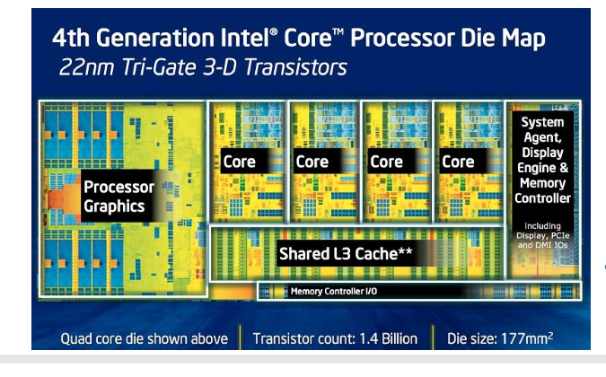
CPU Architecture
Symmetric Multiprocessing
CPU has more than one (identical) core
e.g. Intel Core i7 series has 2, 4, (4 is most common) or 6 cores , note i9 series can have 10 cores
cores work in parallel
thus more than one instruction executed at once

Slide 16
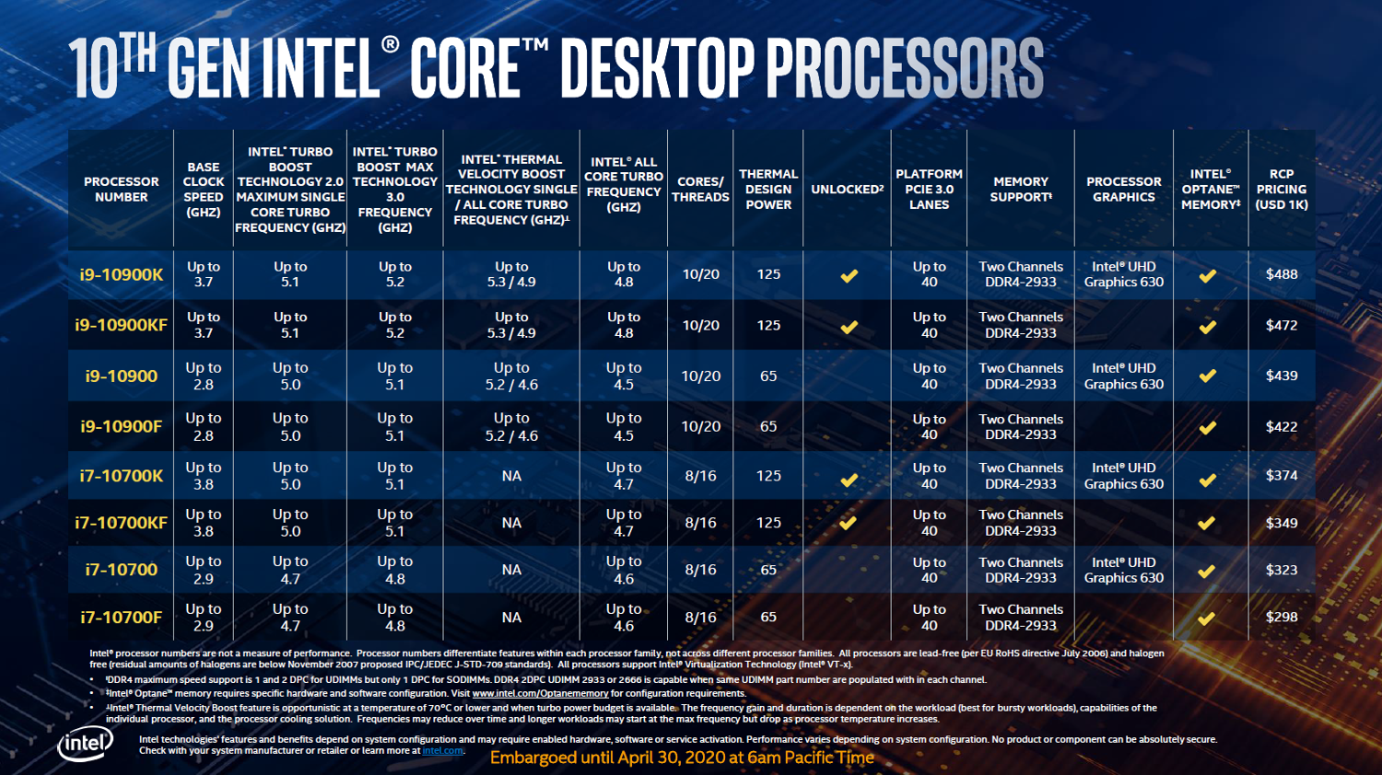
CPU Architecture
https://www.crn.com/news/components-peripherals/new-intel-core-desktop-cpus-pack-up-to-5-3ghz-10-cores
https://ark.intel.com/content/www/us/en/ark/products/199332/intel-core-i9-10900k-processor-20m-cache-up-to-5-30-ghz.html

Slide 17
RISC and CISC Architecture
CPU architecture can be broadly classified into two different types:
CISC – Complex Instruction Set Computer
RISC – Reduced Instruction Set Computer
Another distinction that can be made is the Von Neumann model memory vs the Harvard memory model
http://www.differencebetween.net/technology/difference-between-von-neumann-and-harvard-architecture/#:~:text=Unlike%20Von%20Neumann%20architecture%20which,the%20way%20they%20access%20memories.

Slide 18
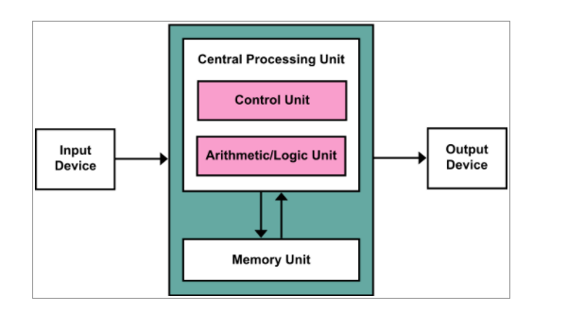
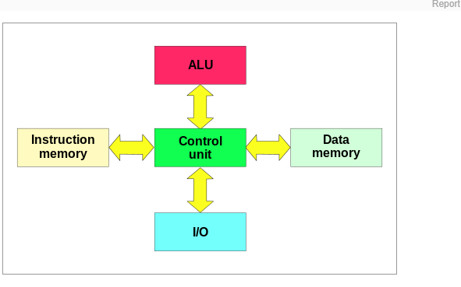
Von Neumann Model versus Harvard Model
Von Neumann Model
Harvard Model
Separate buses for data and
instructions

Slide 19
CISC – Complex Instruction Set Computer
When modern CPU’s were first developed, memory was very expensive
Programs could be smaller if instructions were more powerful and could perform multiple operations
Example:
Multiply two numbers together store the result.
HLL: c = a * b;
CISC MULT A,B,C

Slide 20
CISC
Multiple operations lead to many different kinds of instructions that access memory
This results in variable length instructions and fetch-decode-execute time unpredictability
– making it more complex
Thus hardware handles the complexity
x86 hardware is like this

Slide 21
RISC
Attempt to make architecture simpler
Reduced number of instructions in the instruction set
Need more instructions to do the same thing compared to CISC
Try to reduce the number of memory accesses required by increasing the number of registers
The multiply example would become:
LOAD A,1 LOAD B,2 MULT 1,2 STORE 1,C

Slide 22
RISC
A RISC processor will generally have:
A large number of general purpose registers
A small number of instructions with the same format
Optimisation of instruction pipeline
Uniform instruction size and format should make pipelining easier

Slide 23
RISC
 | CISC processor Intel 80486 | RISC processor Sun SPARC
Year developed | 1989 | 1987
No. instructions | 235 | 69
Instruction Size (bytes) | 1-11 | 4
Addressing modes | 11 | 1
GP Registers | 8 | 40-520

Slide 24
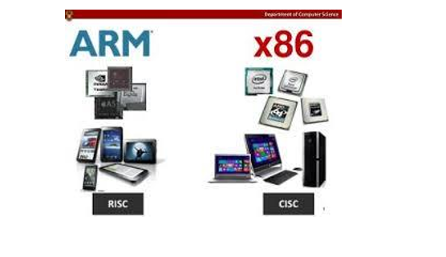
Which is faster?
Program Time = (Cycle Time X Cycles per Instruction) X no of instructions in program
=> Program Time = (Cycle Time / IPC ) X no of instructions in program

Slide 25
CISC versus RISC
CISC | RISC
Emphasis on hardware | Emphasis on software
Multiple instruction sizes and formats | Instructions of same set with few formats
Less Registers | Uses more registers
More addressing modes | Fewer addressing modes
Extensive use of microprogramming | Complexity in compiler
Instructions take varying amount of cycle time | Instructions take one cycle time
Pipelining was difficult in the past but CISC has been redesigned and pipelining has been added. | Pipelining is easy
RISC
each instruction takes the same time,
simpler architecture-> smaller, faster, more cache

Slide 26
CPU Architecture - Multicores
Computation speed-up of a task not linear
many problems are not 100% parallelisable
overhead involved in coordinating sharing of work between cores
access to memory must be coordinated
keeping each core’s cache consistent is difficult
Often each core is performing a different task

Slide 27
CPU Architecture –Introduction to Threads
A thread is a basic unit of CPU utilisation.
A thread would execute a particular sequence of instructions of the process e.g., handling the “graphics” instructions of a mobile phone.
You can have a traditional (heavyweight) single-threaded process (since it is similar to a real process but executes within the context of a process and shares the same resources allotted to the process by the kernel) or a multi-threaded process.

Slide 28
CPU Architecture -SMT
Simultaneous Multithreading (SMT)
pipeline stalls are inevitable – so use that wasted CPU time
use stalls in running one thread of execution to run another thread of execution
operating system thus sees a single core as two logical cores, and schedules different tasks to each
example: Intel’s Hyper-threading

Slide 29
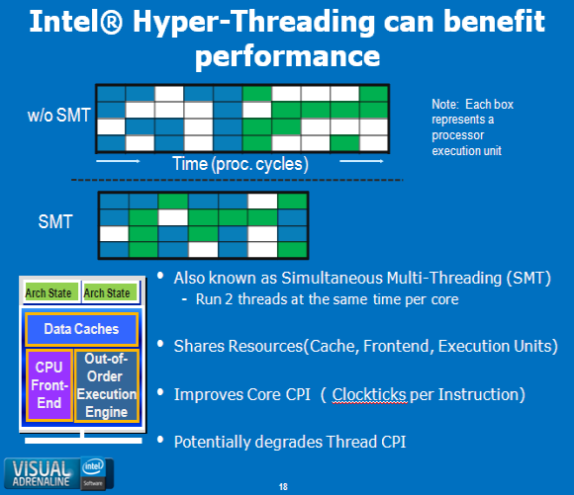
CPU Architecture-Hyper-Threading

Slide 30
CPU Architecture-Hyper-Threading
Note they are equivalent- same number of green and blue processing execution units for the 2 threads.
"Throughput" for the SMT will be greater assuming there are no "bottlenecks". In SMT the 2 threads are doing work in the bubbles- the white squares.
A "system programmer" - in charge of writing software for "operating systems" has written an algorithm to handle 2 threads like this. The SMT diagram seems a reasonable result for such an algorithm.

Slide 31
Other Processing Models
In the “standard” CPU model, the CPU executes one instruction at a time, operating on one piece of data
Eg
Load A ,1 Load B, 2
This is known as a Single Instruction, Single Data or SISD computer

Slide 32
Parallel Processing
Some applications, especially graphics related, perform the same calculations many times, but on different data
This type of processing can be made much faster if we are able to perform the same calculation on many different pieces of data at once
To see how this can work we first need a basic understanding of the main steps involved in graphics processing…

Slide 33
Graphics Processing
Ultimate goal: display a series of images on a screen (2D)
Images consist of pixels, which have colour and brightness
However the internal model of an image is a collection of 3D objects and a lighting source

Slide 34
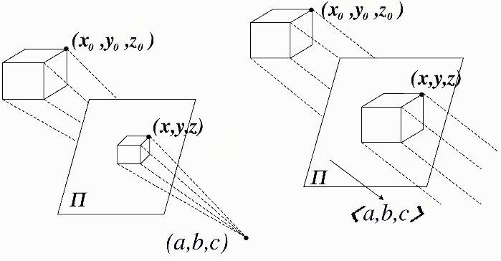
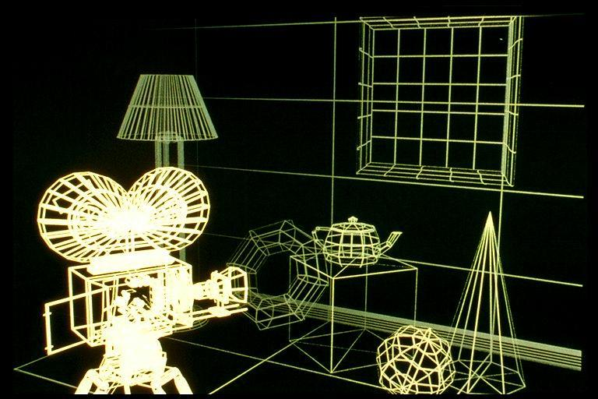
Graphics Processing
Shapes are represented as coordinates in 3D space)

Slide 35

Graphics
We also have some shading, or texture information to add in

Slide 36

Graphics
Surfaces are normally broken up into triangles, and these are very easy to manipulate mathematically.
Curved surfaces are approximated by using a very large number of triangles

Slide 37
Graphics
As the “camera” or view changes the objects need to be rotated around an arbitrary point
The change in position can be calculated by applying a rotation matrix to all of the vertices (i.e. same instructions applied to a large amount of data)

Slide 38
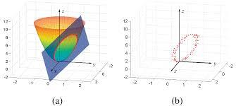
Perspective
Once rotation is complete, we need to determine which objects, or parts of objects are visible from a given position (Camera Position)
This requires calculating points of intersection
Again same calculations applied to lots of different data

Slide 39
Perspective
All these steps involve lots of calculations on three dimensional coordinates, and hence a lot of matrix calculations
However in many cases the same calculation is repeated performed on different data

Slide 40
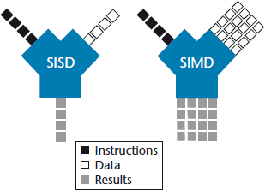
SIMD
In a Single Instruction Multiple Data Computer model, one instruction can operate on multiple data sets

Slide 41
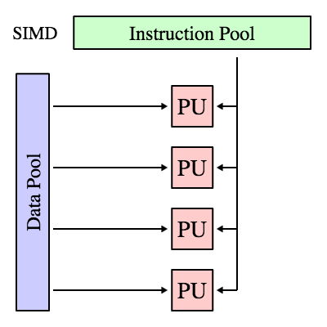
SIMD
This is implemented as multiple processors that each follow the same instructions, but have some local memory where they can store the data it is working on

Slide 42
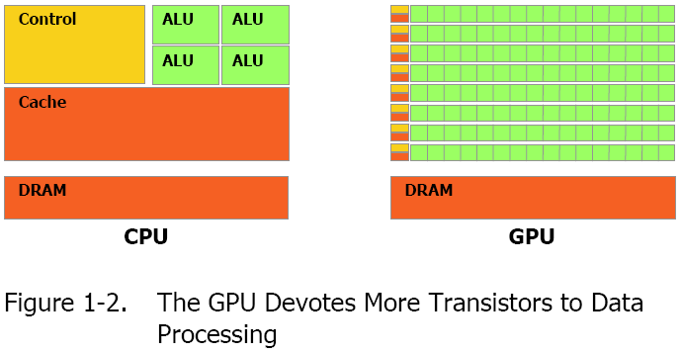
CPU vs GPU
A typical GPU has many more processors compared to a CPU

Slide 43
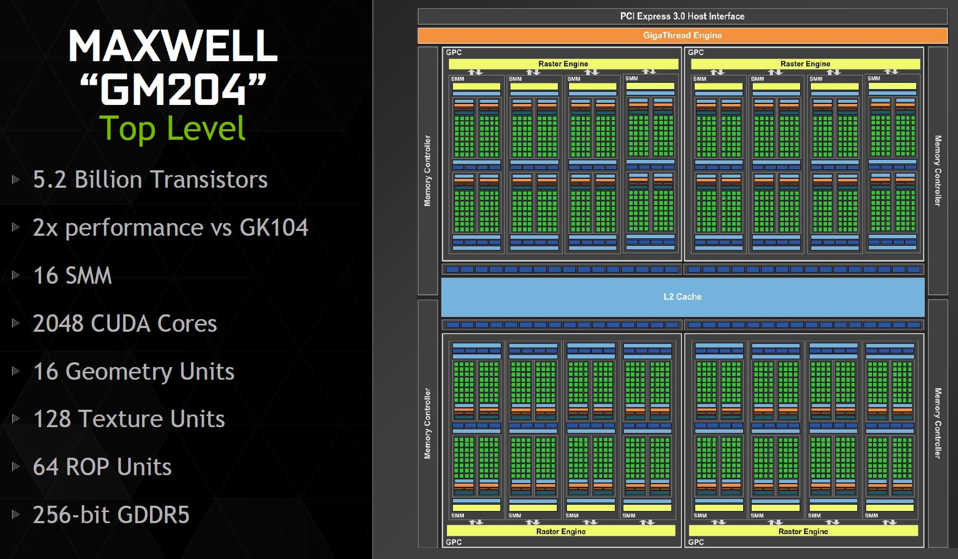
Nvida Maxwell Architechure

Slide 44
SIMD
SIMD processors are particularly useful in applications where the same operation needs to be applied to large amounts of data such as
Digital Signal Processing (DSP)
Computer Graphics
https://docs.nvidia.com/cuda/maxwell-tuning-guide/index.html
https://techterms.com/definition/cuda#:~:text=CUDA,both%20the%20CPU%20and%20GPU.&text=While%20CUDA%20only%20supports%20NVIDIA,with%20several%20different%20programming%20languages
http://download.nvidia.com/developer/cuda/seminar/TDCI_Arch.pdf https://www.techwalla.com/articles/128-bit-vs-256-bit-graphics-card

